Slide 1
Chapter 15

Slide 2
Objectives

Slide 3
Objectives (cont.)

Slide 4
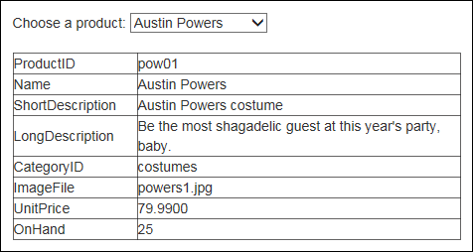
A DetailsView control that displays data for a selected product

Slide 5
The aspx code for the DetailsView control

Slide 6
Three modes of the DetailsView control

Slide 7
DetailsView control properties

Slide 8
DetailsView child elements

Slide 9
Fields child elements

Slide 10
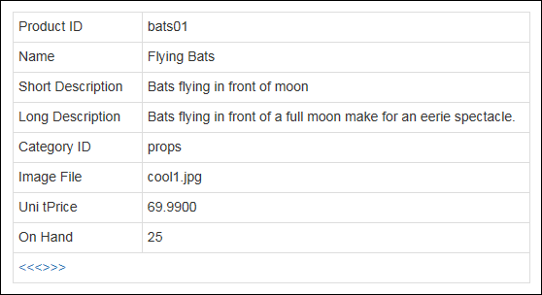
A DetailsView control that allows paging

Slide 11
The aspx code for the DetailsView control

Slide 12
The aspx code for the DetailsView control (cont.)

Slide 13
A Master/Detail page typically contains:

Slide 14
A SqlDataSource control with a parameter that’s bound to a drop-down list

Slide 15
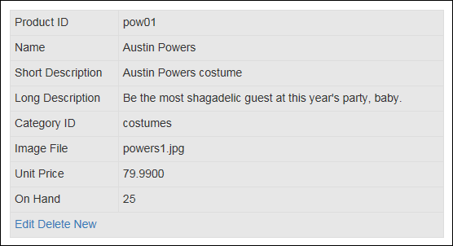
A DetailsView control with automatically generated command buttons

Slide 16
DetailsView control command buttons

Slide 17
Properties that generate command buttons

Slide 18
A DetailsView element that automatically generates command buttons

Slide 19
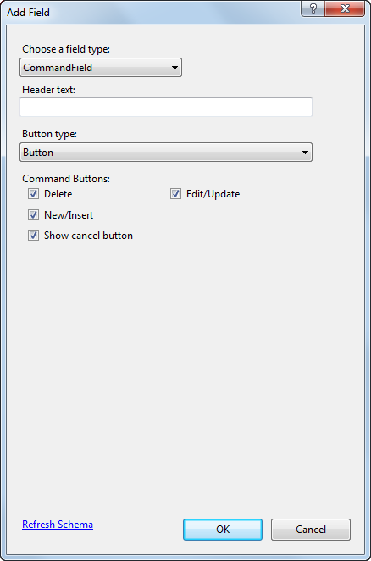
The Add Field dialog box for adding a command field

Slide 20
Code generated by the Add Field dialog box

Slide 21
Events raised by the DetailsView control

Slide 22
An event handler for the ItemUpdated event

Slide 23
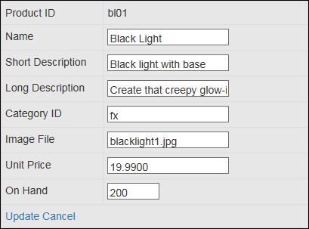
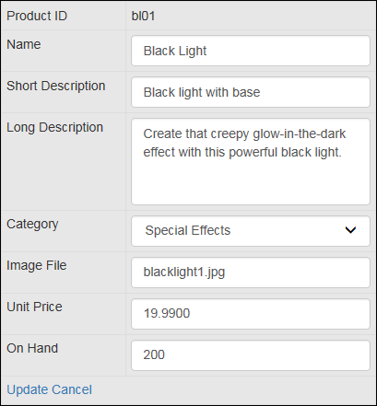
A DetailsView control in Edit mode without and with templates

Slide 24
DetailsView template elements

Slide 25
The aspx code for a custom template field

Slide 26
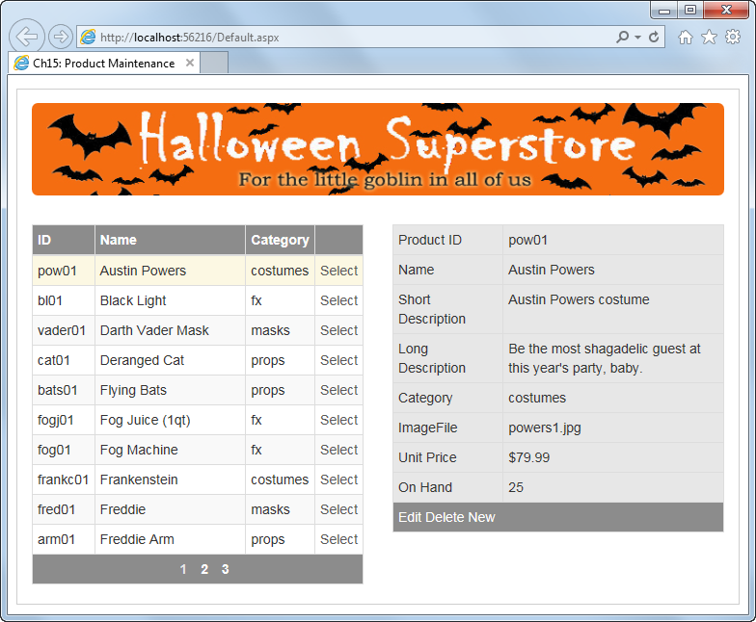
The Product Maintenance application

Slide 27
The Default.aspx file

Slide 28
The Default.aspx file (cont.)

Slide 29
The Default.aspx file (cont.)

Slide 30
The Default.aspx file (cont.)

Slide 31
The Default.aspx file (cont.)

Slide 32
The Default.aspx file (cont.)

Slide 33
The Default.aspx file (cont.)

Slide 34
The Default.aspx file (cont.)

Slide 35
The Default.aspx file (cont.)

Slide 36
The Default.aspx file (cont.)

Slide 37
The Default.aspx file (cont.)

Slide 38
The Default.aspx file (cont.)

Slide 39
The Default.aspx file (cont.)

Slide 40
The Default.aspx.cs file

Slide 41
The Default.aspx.cs file (cont.)

Slide 42
The Default.aspx.cs file (cont.)

Slide 43
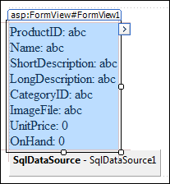
A FormView control after a data source has been assigned

Slide 44
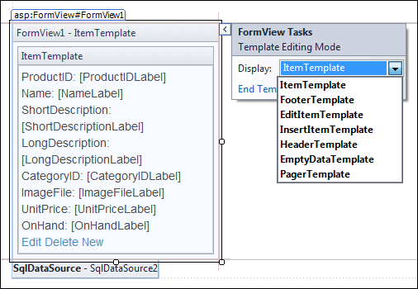
A FormView control in template-editing mode

Slide 45
How the FormView control differs from the DetailsView control

Slide 46
The Item template generated for a FormView control

Slide 47
The Item template generated for a FormView control (cont.)

Slide 48
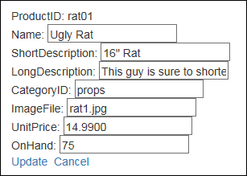
A generated EditItem template in a browser

Slide 49
The aspx code for the EditItem template

Slide 50
The aspx code for the EditItem template (cont.)

Slide 51
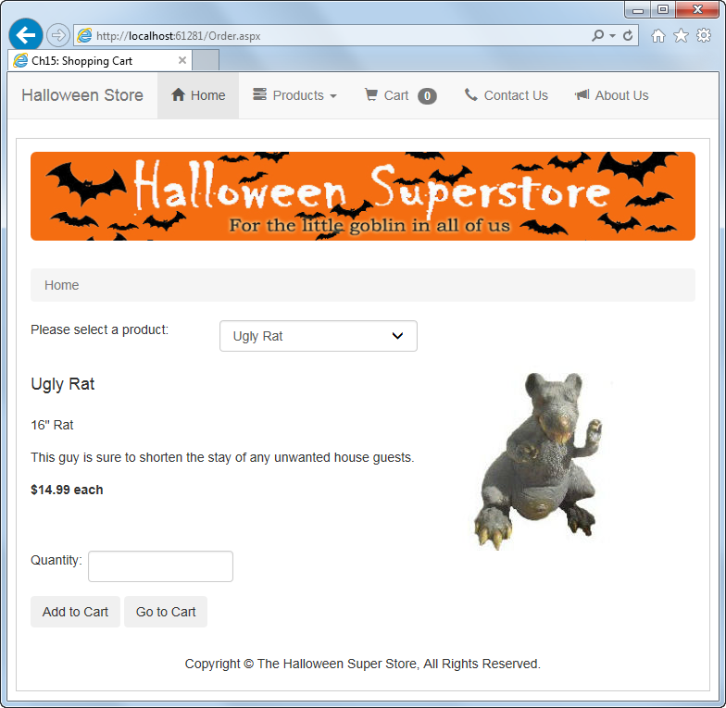
The Order page of the Shopping Cart application

Slide 52
The Order.aspx file

Slide 53
The Order.aspx file (cont.)

Slide 54
The Order.aspx file (cont.)

Slide 55
The Order.aspx file (cont.)

Slide 56
The Order.aspx file (cont.)

Slide 57
The Order.aspx file (cont.)

Slide 58
The Order.aspx.cs file

Slide 59
The Order.aspx.cs file (cont.)

Slide 60
The Order.aspx.cs file (cont.)

Slide 61
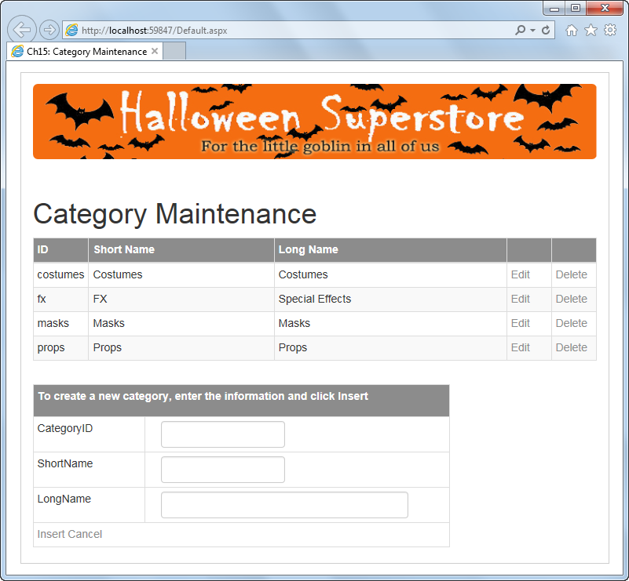
Extra 15-1 Use a DetailsView control to insert rows

Slide 62
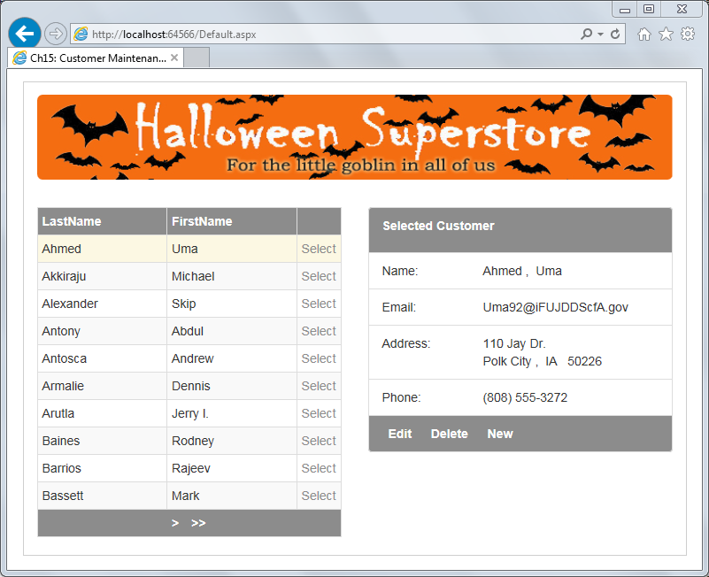
Extra 15-2 Format the data in a FormView control

